Slide 1







A new generation
of tech specialists

Slide 2
Mental Health Detection from Social Media Posts
By Group 12
Phyo Ko Ko
Aung Thu Phyo
Su Mon Hlaing
Moe Thet Hmue
Nang Mon Kham

Slide 3
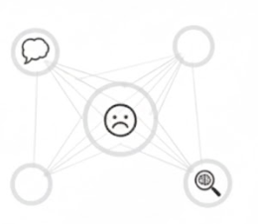
Background
  Context : Mental health is a critical component of global well-being. Platforms like Facebook and X are primary forums for personal expression where users share emotions, creating a massive data stream where distress signals are often lost.
  Problem: Traditional manual support and reactive reporting tools cannot handle the volume of millions of daily posts. Subtle linguistic patterns of distress often go unnoticed until a crisis becomes apparent.
  Solution Necessity: An automated NLP-driven approach is required to analyze text at scale to bridge the gap between expression of distress and professional support.

Slide 4


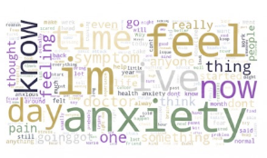

Objectives
Real Time Detection : Automatically classify and detect mental helath conditions from social medial posts
Leverages machine learning models to classify mental health conditions from real-time social media text data.
Contextual Analysis
Utilize fine-tuned DistilBert Model to identify patterns related to mental health states and provide fast, reliable deployed cloud API

Slide 5


SDG Relation
By supporting early awareness of mental-health risk patterns, the system aims to assist organizations in promoting mental well-being and prevention, while avoiding harmful automation.
By leveraging modern NLP models and cloud-based APIs, the system demonstrates how AI can be applied to analyze large-scale social-media data. The project emphasizes scalable, modular design and supports innovation in digital monitoring tools.

Slide 6
Data

Slide 7
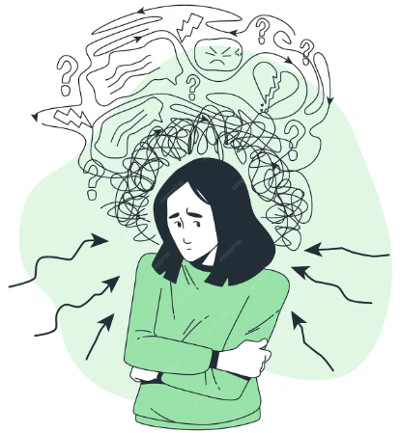
Data
  Source : Primary dataset from Kaggle (Mental Health Sentiment Analysis)
  Characteristics:
  Short, informal text
  Emotionally expressive language
  Multiple mental-health categories
  Live social-media posts (scraped via API for deployment testing)
Data Source Link : https://www.kaggle.com/code/annastasy/mental-health-sentiment-analysis-nlp-ml/input

Slide 8

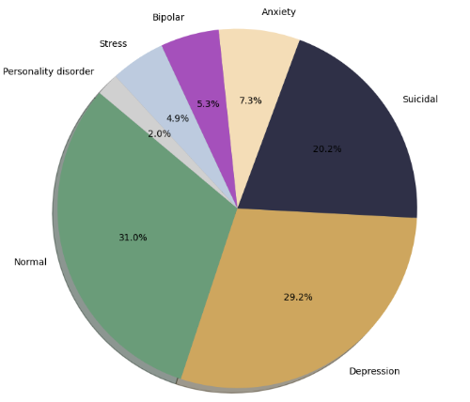
Data Preprocessing
Text Cleaning and Normalization
Removal of empty data / invalid Posts
Translation of non-english to enlgish for modal compatibility
Used Random Over Sampler for unbalanced data
Preservation of original text for human review and transparency

Slide 9
Model

Slide 10
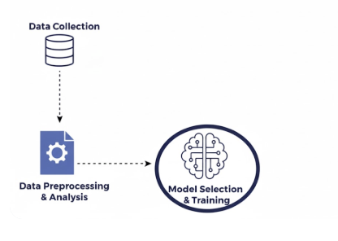
Model Selection
Baseline Approach
Initially experimented with classic models (Logistic Regression, XGBoost) using TF-IDF features
Limitation: Failed to capture context (e.g., distinguishing "not happy" from "happy") due to lack of sequence awareness
                Selected Architecture
  DistilBERT (distilbert-base-uncased)
  Contextual Intelligence: Uses self-attention to understand the relationship between words across the entire sentence.

Slide 11
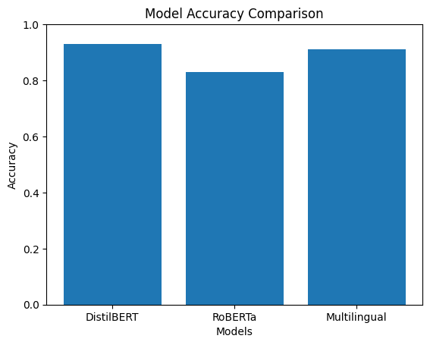
Models Comparison
Efficiency: Chosen for its superior balance of high accuracy (~93%) and faster inference speed compared to larger models like RoBERTa.

Slide 12

Model Training and testing
  Training Configuration:
    Tokenization: Switched to WordPiece to break words into meaningful sub-words, preserving semantic value better than stemming .
    Optimization: Utilized Optuna to verify optimal learning rates
    Execution: Fine-tuned for 2 epochs with a batch size of 16 using the Hugging Face Trainer API.
  Testing Protocol:
    Data Split: Evaluated on a 20% held-out test set strictly unseen during training to ensure valid performance metrics.
    Primary Metric: Prioritized Weighted F1-Score to ensure a safe balance between Precision (accuracy of flags) and Recall (catching true cases).

Slide 13
Result

Slide 14
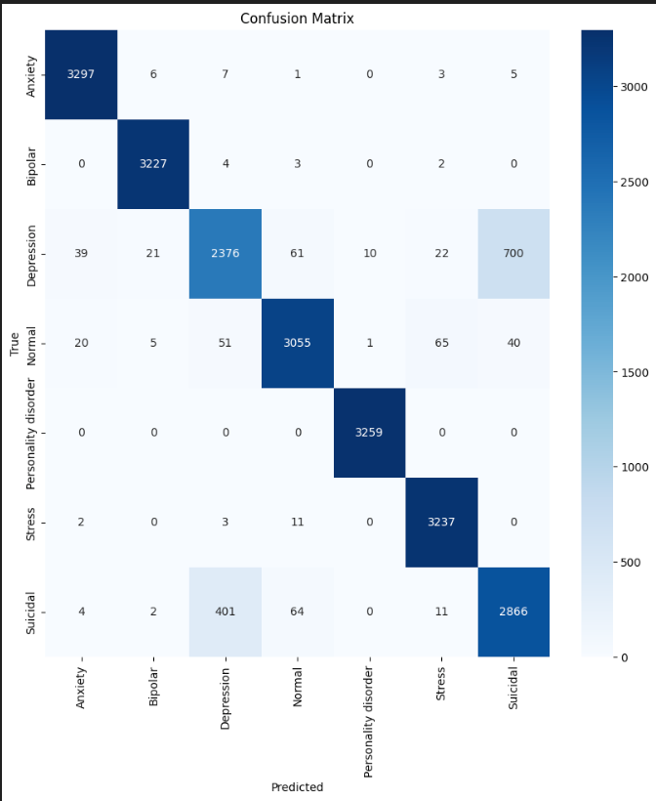
Evaluation Results
Category | Precision | Recall | F1 -Score
Anxiety | 0.98 | 0.99 | 0.99
Bipolar | 0.99 | 1.00 | 0.99
Depression | 0.84 | 0.74 | 0.78
Normal | 0.96 | 0.94 | 0.95
Personality Disorder | 1.00 | 1.00 | 1.00
Stress | 0.97 | 1.00 | 0.98
Sucidial | 0.79 | 0.86 | 0.82
Test Accuracy | Test Accuracy | 0.93 | 0.93

Slide 15
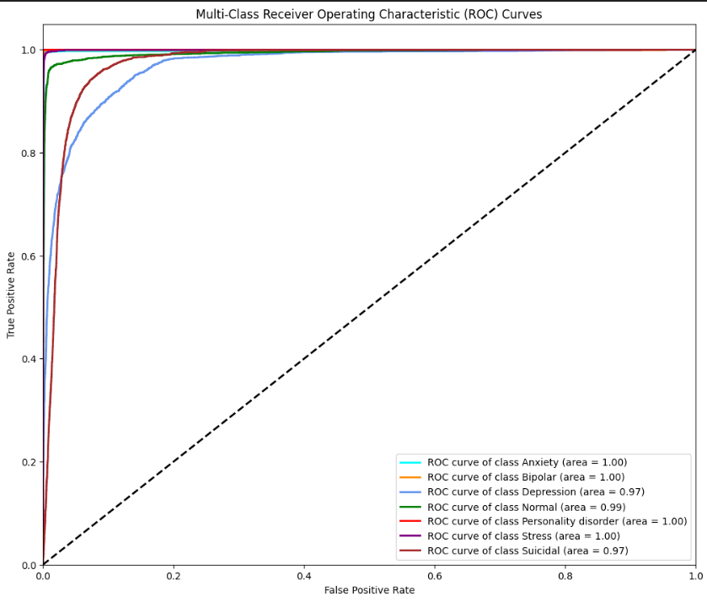
Evaluation Results

Slide 16
Deployment

Slide 17
Deployment
  Platform: Deployed on Azure Machine Learning using a Managed Online Endpoint for real-time inference.
  Workflow:
    Input: Logic App receives a post URL.
    Scoring: score.py script loads the model and tokenizes text.
    Safety: Inference runs on a secure Standard_DS2_v2 instance.
    Output: JSON response with predicted status and probability.

Slide 18
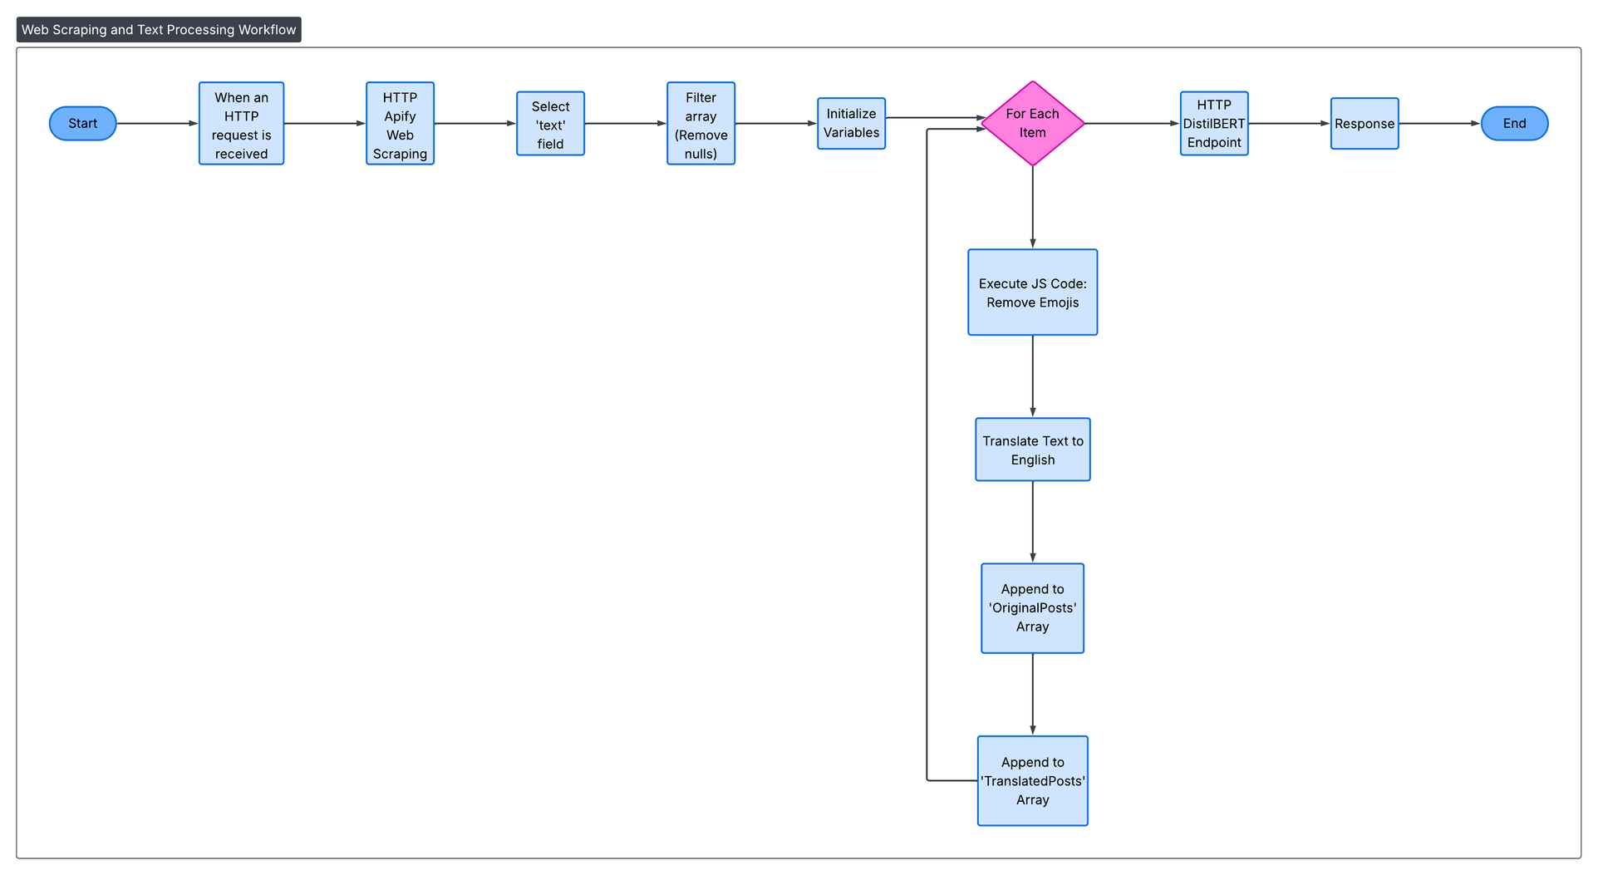
Deployment

Slide 19
Conclusion
  Bilingual Resource: Created a custom 2,000-sample dataset in English and Myanmar (Combined_Data_2000_en_my.csv), addressing the low-resource language gap.
  Proven Performance: Successfully implemented a Transformer-based model for effective cross-lingual text classification.
  Social Impact: Enables automated monitoring of social-media text to identify potentially harmful mental-health content, supporting SDG 3 (Good Health and Well-Being) through early risk detection and SDG 9 (Industry, Innovation, and Infrastructure) by applying AI-driven NLP systems to social platforms.

Slide 20
Futurework
  Data Expansion: Scale dataset to cover slang, dialects, and both Zawgyi/Unicode fonts.
  Deployment: Launch as a real-time Web API or mobile app for instant predictions.
  Multimodal Model: Integrate Speech-to-Text to analyze voice messages (popular in Myanmar).
  Granularity: Upgrade from simple sentiment (Positive/Negative) to specific emotion detection (Joy, Anger, Fear).

Slide 21


Thank you!

